Slide 1
Everything You Wanted to Know About the Health of Your DAM Deployment!
Yassir Saeed - Director
Richard St. John - Architect
Consulting Services, Imperva

Slide 2
Speakers Bio
Yassir Saeed Director, Consulting Services
Joined Imperva in 2016
Have more than 10 years experience leading enterprise Data security deployments
Leading Imperva Consulting team across North America and EMEA
Based out of Dallas, Texas
Richard St. John
Architect, Consulting Services
Joined Imperva 2010
Performs engagements for all sizes of customers
Based outside St. Louis, Missouri
Prior To Imperva was Cyberwarfare Instructor with EADS and Data Security Infrastructure Manager in the corporate world

Slide 3
Agenda
Why do a health check
Imperva DSF reference architecture
What to check on a health check
Sizing
Capacity
Security Alerts
Audit Events
System Events
Agent
Archive & Backups
Proactive maintenance/monitoring
Data Security Services & Training
Q&A

Slide 4
Why Do A Health Check
Identifying issues before they occur
Alert to any Instabilities Proactively
Scale & Expand with Confidence
Notes:
Proactively address health issues before they become major problems, by implementing the right processes and procedures.
Assess your current capacity and perform sizing for future expansion with confidence.
Leverage advanced monitoring and security capabilities to ensure maximum efficiency and reliability of your solution, while getting the most out of your investment.

Slide 5
What A Health Check Does
The Health Check is designed to
Produce a “moment in time” view of how the Imperva systems are functioning
Identify any deficiencies in the system which could lead to data loss
Identify Imperva best practices in relationship to the implemented system
Provide recommendations for a customer to review and implement
The health check identifies issues at:
The component level
SOM, MX, GW, Agents
The implementation level
MX and associated gateways as a whole
The system level
Multiple implementations viewed as a single system

Slide 6
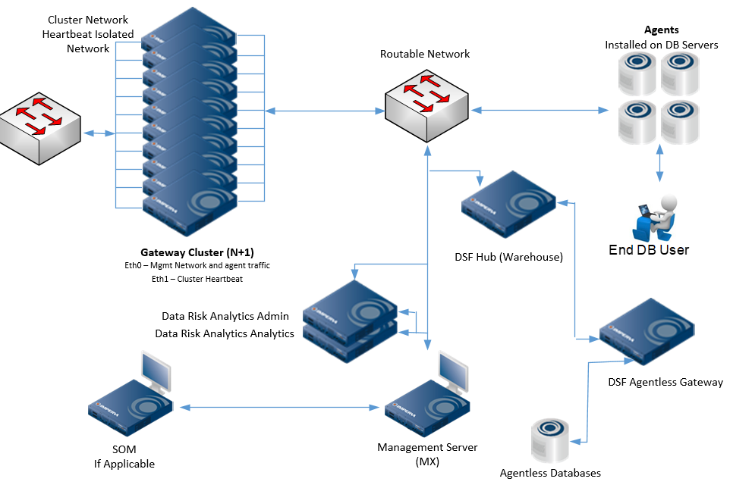
DSF Reference Architecture

Slide 7
Components Reviewed
SecureSphere Operations Manager (SOM)
Management Server (MX)
Gateway (GW)
Agents

Slide 8
Sizing
Sizing is done by Imperva personnel based on logical cores of the server to be protected
Referred to as a Theoretical Maximum
This theoretical maximum then determines the number of gateways needed to protect a specific amount of cores
Imperva PD determined that a single logical core in a server can handle 100 database transactions/sec with its other duties to the OS
Example Sizing:
Customer provides core count: 1750
1750 cores / 162 = 10.80 V6500 Gateways = 12 V6500 Clustered non-large scale Gateways
1750 cores / 480 = 3.645 V6500 Gateways = 5 V6500 Clustered large scale Gateways

Slide 9
Sizing
Real Life Sizing Example for Large Scale Gateways
MXA: 6,156 cores in 93 servers
MXB: 6,794 cores in 152 servers
MXC: 4,428 cores in 142 servers
MXA
6156/480=12.82=13 RAW=14 Clustered v6500
MXB
6794/480=14.15=15 RAW=16 Clustered v6500
MXC
4428/480=9.22=10 RAW=11 Clustered v6500
# Cores in Server | MXA | MXB | MXC | Total
672 | 3 |  |  | 3
192 | 11 | 20 | 4 | 35
128 | 1 | 1 | 1 | 3
96 | 3 | 1 | 4 | 8
88 | 2 |  | 5 | 7
64 |  | 5 |  | 5
60 | 4 | 4 | 4 | 12
48 | 2 | 2 | 1 | 5
44 |  |  | 6 | 6
40 |  | 2 |  | 2
32 | 6 | 31 | 24 | 61
28 |  |  | 1 | 1
24 | 9 | 8 | 19 | 36
20 | 12 | 13 | 23 | 48
16 | 21 | 19 | 14 | 54
12 | 2 |  | 4 | 6
10 | 1 |  | 1 | 2
8 | 5 | 18 | 10 | 33
6 |  | 3 | 3 | 6
4 | 10 | 17 | 14 | 41
2 | 1 | 8 | 4 | 13
Total Agents | 93 | 152 | 142 | 387
Total Cores | 6,156 | 6,794 | 4,428 | 17,378

Slide 10
Capacity
As opposed to sizing, capacity is the known system use over time
Referred to as an Imperva Performance Unit (IPU)
The IPU is used by the cluster load balancing algorithm
An agent sitting on 24 cores may only generate usage of 3 cores
Capacity is reviewed to make sure that the infrastructure is not overloaded or overburdened

Slide 11
Capacity
Capacity Can Be Reviewed in the GUI at SETUP -> CLUSTER MANAGEMENT -> AGENTS

Slide 12
Security Alert Analysis
OOB and custom Security Alerts can be reviewed for trends such as:
Environmental Signatures. DB Vendor says they are dangerous but used in the environment
Users causing most alerts in environments
Servers with the most security alerts

Slide 13
Security Alert Analysis
Example:
Signature | Num. of Events
part="DBMS_SQL",rgxp="DBMS_SQL\s?\.\s?" | 129,498
part="execute", part="immediate", rgxp="execute\s*immediate" | 123,714
part="DBMS_DRS", rgxp="DBMS_DRS\s?\." | 36,739
part="DBMS_DRS",part="GET_PROPERTY", rgxp="DBMS_DRS\s?\.\s?GET_PROPERTY" | 36,136
part="events", rgxp="alter\s?session\s?set\s?events" | 23,337
part="dbms_scheduler",rgxp="dbms_scheduler\s?\." | 22,729
part="DBMS_SNAPSHOT_UTL", part="VERIFY_LOG", rgxp="DBMS_SNAPSHOT_UTL(\s)?\.(\s)?VERIFY_LOG" | 18,926
part="DBMS_METADATA", part="GET_DDL" | 12,894
part="xp_cmdshell" | 12,456
part="DBMS_SQL.EXECUTE" | 11,642

Slide 14
Audit Events vs Security Alerts
A single SQL event is compared to all Security and all Audit policies assigned to the specific application, service or server group
Meaning a single SQL event can create multiple audit records or multiple security alerts
Security alerts are generated by the system in regards to patterns found within the SQL Events that trigger policies and/or signatures
Audit events are SQL events that policies consider interesting
A simpler way of thinking about it:
Audit events are what we record for posterity
Security Alerts are what the system yells about

Slide 15
Audit Events
“Select * from dual” is a single SQL event that an audit policy may consider interesting
As mentioned every SQL event entering the gateway is compared against the match criteria of all policies applied to the specific application, service or server group
If the event matches a policy: it is considered interesting and saved to appropriate location on gateway
If the event does not match a policy: it is dropped from memory
In Non-Large Scale MXs policy event counts are at AUDIT -> MANAGEMENT STATISTICS -> POLICIES

Slide 16
Audit Events
Data Example Across Multiple MX Implementations:
Policy Name | MXA | MXB | MXC | Total
Default Rule - All Events - 14.9 - Native NLS | 229,416,358 | 93,605,877 | 445,366,400 | 768,388,635
Privileged Operations Not By DBAs |  | 660,795,047 |  | 660,795,047
Out of timeframe changes |  | 451,353,701 |  | 451,353,701
No Ticket Changes |  |  | 339,207,861 | 339,207,861
SQL Exceptions Generated | 5,424,978 | 68,456,820 | 114,232,207 | 188,114,005
SAP Suspicious Activity D2A | 156,158,796 |  |  | 156,158,796
Login & Logouts | 37,571,932 | 29,268,348 | 45,195,130 | 112,035,410
User rstjohn activity |  | 73,699,047 |  | 73,699,047
Privileged Operations By DBAs | 72,894,389 |  |  | 72,894,389
Login From Unauthorized Sources | 72,766,030 |  |  | 72,766,030
Total | 574,232,483 | 1,377,178,840 | 944,001,598 | 2,895,412,921

Slide 17
System Events
System Events are
Events that directly impact the Imperva Infrastructure
Agent Up/Down
Gateway Up/Down
GUI login/Logout
Recorded automatically by the systems

Slide 18
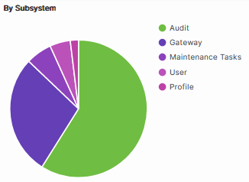
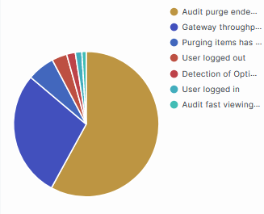
System Events
Health check provides review the system events for trends that could impact the normal operation of the systems

Slide 19
Agent Analysis
Agent information can be reviewed for
Top inbound data receivers
Top outbound data senders
# Data channels (excessive)
Missing Installation Managers
Not correctly configured agents
Capping events
Agent Traffic Distribution (TD) analysis can be viewed in the GUI at SETUP -> CLUSTER MANAGEMENT -> AGENTS -> Select Agent(s) -> TRAFFIC DISTRIBUTION
OOB configuration is first 100 agents only collect TD
Agents can be turned on and off in the GUI at SETUP -> CLUSTER MANAGEMENT -> AGENTS -> Select Agent -> TRAFFIC DISTRIBUTION COLLECTION (check/uncheck)

Slide 20
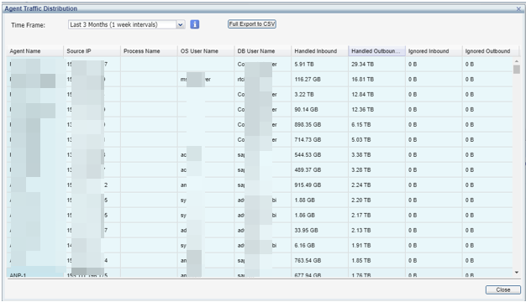
Agent Traffic Distribution Analysis
Multiple agent example
All columns are sortable

Slide 21
Archive & Backups
Traditional Archives and Backups can be performed via
NFS Mount
FTP
SCP
Traditional file based backups are reviewed to ensure completion and are not failing
Some companies have done away with backups in the traditional sense and use ESX, Azure & AWS disk snapshot capabilities vs file based backups
Some companies that have Data Security Hub may not back up their gateway data to MPRV files, instead send the data in near real time to the DSF Warehouse, then backup the DSF via HA-DR or Snapshots

Slide 22
Proactive Maintenance/Monitoring
Review the systems for System Events and any associated followed actions
System events can be sent to external systems via action sets such as
Syslog
SNMP
E-Mail
Logic can be created in the external systems to generate alerts to NOC, SOC, Security or SysAdmin teams
Basic OS level syslog can be done via the Linux rsyslog server that is on the appliance

Slide 23
Where Does Health Check Data Come From
GTIs
Gateways, Management Servers, SOM
Gateway Performance CSVs
Gateways
Agent CSVs
Agents
Custom Reports
Multiple can be imported for Health Check and then used by customer on a day to day
Custom Script
Non-Intrusive Professional Service script

Slide 24
Get Tech Infos
Available from each device, contains:
Counters
Logs
Basic Configurations
Reviewed for:
Excessive errors
Overloads
Odd Configurations
Odd happenings

Slide 25
Get Tech Infos
Example Data from DAM System
Responses from databases by record counts ranges
# Records per Response | MXA | MXB | MXC | Total
[0-31] | 16,295,758,118 | 12,882,291,738 | 5,518,414,219 | 34,696,464,075
[32-63] | 206,628,371 | 350,524,108 | 66,109,012 | 623,261,491
[64-127] | 245,911,810 | 311,206,944 | 52,917,520 | 610,036,274
[128-255] | 24,564,379 | 102,785,702 | 51,073,586 | 178,423,667
[256-511] | 20,331,514 | 74,119,601 | 8,899,924 | 103,351,039
[512-1023] | 13,149,222 | 26,874,329 | 5,165,535 | 45,189,086
[1024-2047] | 65,961,879 | 12,987,201 | 2,157,207 | 81,106,287
[2048-4095] | 4,753,264 | 8,608,823 | 2,729,747 | 16,091,834
[4096-8191] | 3,237,985 | 2,497,477 | 2,209,996 | 7,945,458
[8192-16383] | 3,409,680 | 6,142,912 | 656,170 | 10,208,762
[16384-32767] | 3,830,261 | 725,743 | 2,505,344 | 7,061,348
[32768-65535] | 757,137 | 816,359 | 694,528 | 2,268,024
[65536-131071] | 2,973,138 | 184,304 | 468,880 | 3,626,322
[131072-262143] | 1,604,762 | 135,237 | 130,069 | 1,870,068
[262144-524287] | 633,942 | 63,577 | 67,678 | 765,197
[524288-1048575] | 176,774 | 17,469 | 50,540 | 244,783
[>=1048576] | 76,273 | 33,500 | 108,528 | 218,301
 | 16,893,758,509 | 13,780,015,024 | 5,714,358,483 | 36,388,132,016

Slide 26
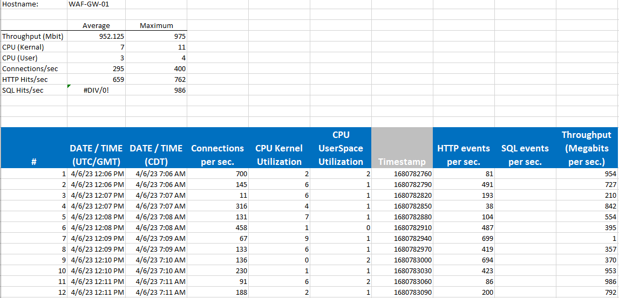
Gateway Traffic Analysis (CSV)
Data gathered automatically every 30 seconds by gateway
Only three days of data
Available as a CSV for human consumption
Allows 30 second snapshots of:
Connections
CPU Usage
Throughput
HTTP Hits (if WAF)
SQL Hits (if DAM)

Slide 27
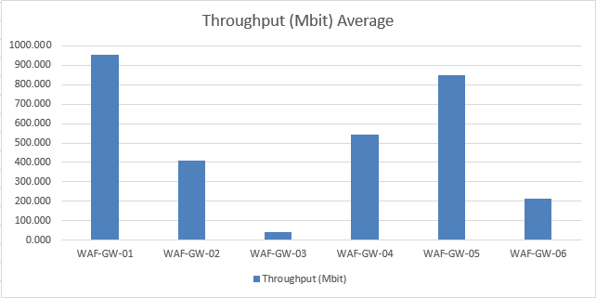
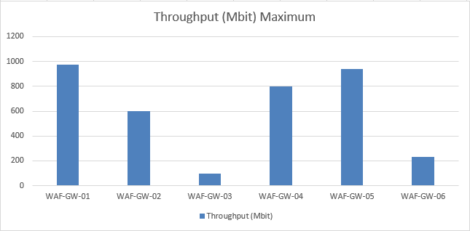
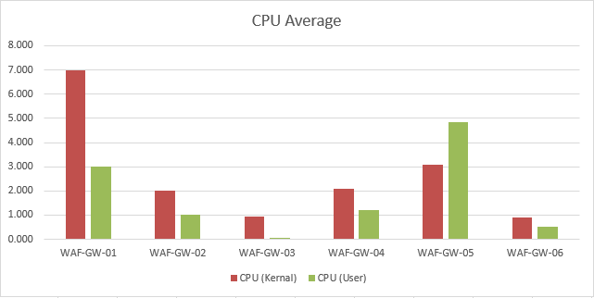
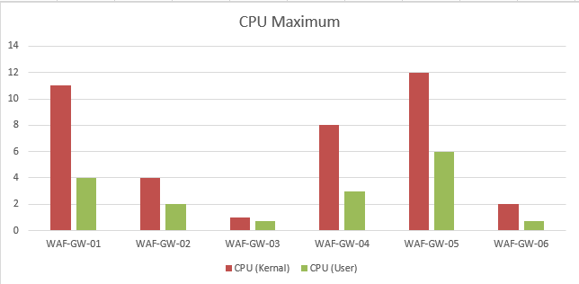
Gateway Traffic Analysis

Slide 28
Data Security Services & Training
Consulting Engagements
Correct Set-up and/-or implementational goals are achieved through custom implementation, resolution and fixes; Time and Material engagements, SoW, and more
Help customer to see value faster or help achieve deadlines and goals throughout their lifecycle
Subscription Services
Renewable services to cover all ongoing consulting, long term onboarding, implementation, and operational needs.
Driving long term success through “best in class” operational support, expertise and insights
Training & Certification
Imperva University to provides your customer with certification and/-or the training to implement and maintain Imperva solutions.
Instructor-led sessions and eLearning classes individually or via subscription.
& Badging and Certification options
Implement, Migrate, Fix & Resolve
Operate, Manage, Long Term Onboarding & Expansion
Learn & Certify
Health Checks
Ongoing Enablement Consulting (OEC)
Managed Services (ES/MS)
for Data Sec.
On Demand Training
QuickStart
Technical Account Manager (TAM)
Subscription Training
Custom Engagements
Designated Support Engineer (DSE)
Certification & Badging
Contact us at proserv-requests@imperva.com to request a service

Slide 29
Q&A

